Slide 1
Self Organizing Map
SOM
Aidos Sarsembayev, IITU, 2018

Slide 2
Outline
(Un)supervised DL
What is SOM?
What SOM is for?
How does SOM work?

Slide 3
Before we start
Deep Learning is divided into 2 groups:
Supervised | UnSupervised
Artificial Neural Networks (ANN) | Self Organizing Maps (SOM)
Convolutional Neural Networks (CNN) | Boltzman Machines (BM)
Recurrent Neural Networks (RNN) | Auto Encoders (AE)
Although this list is not complete, for instance there are also: capsule networks, Generative adversarial networks (GAN), Lean and augmented data learning, Automated machine learning (AutoML) etc.
The above listed are the most popular and well studied models so far.

Slide 4
Before we start
Deep Learning is divided into 2 groups:
Supervised | Application
Artificial Neural Networks (ANN) | The base NN model, gives us the prediction in probabilistic form; used for regression and classification
Convolutional Neural Networks (CNN) | Classification of the data w/ spatial feature (i.g. images); used for Computer Vision
Recurrent Neural Networks (RNN) | Prediction of sequential patterns (i.g. text, continuous numbers); used for time series analysis

Slide 5
Before we start
Deep Learning is divided into 2 groups:
UnSupervised | Application
Self Organizing Maps (SOM) | Used for Features Detection. Recognizes classes in uncategorized data (a type of ANN used for dimensionality reduction)
Boltzman Machines (BM) | Used for Recommendation Systems (type of RNN)
Auto Encoders (AE) | Used for Recommendation Systems. Also a type of ANN used for dimensionality reduction

Slide 6
What is SOM?
It was invented in 1980s by Teuvo Kohonen
SOM is a tool for visualizing low-dimensional views of high-dimensional data, akin to multidimensional scaling.
Data can be 1D, 2D or 3D
Self-organizing maps are a method of clustering the highly dimensional data and arranging the developed clusters onto a grid (at least in the case of 2D)
Easy to implement; reasonably fast and can be scaled for use with large data sets
Basically you take a high dimensioned data (lots of columns of dataset) and stick it into a map (i.g. 2d map)

Slide 7
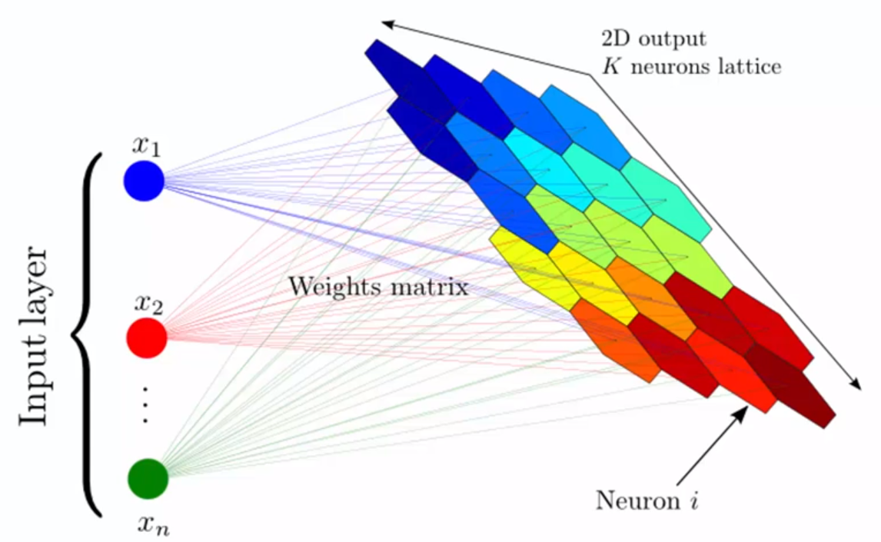
SOM example
Source https://arxiv.org/pdf/1312.5753.pdf

Slide 8
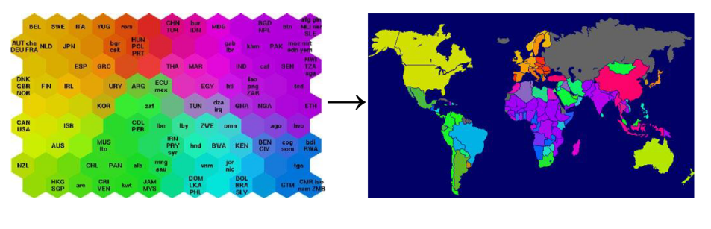
SOM example
Source http://home.cc.umanitoba.ca/~umsidh52/PLNT7690/presentation/SOM.html

Slide 9

Teuvo Kohonen
(born July 11, 1934) is a prominent Finnish academic (Dr. Eng.) and researcher. He is currently professor emeritus of the Academy of Finland.
Source https://en.wikipedia.org/wiki/Teuvo_Kohonen

Slide 10
What SOM is for?
When your data is not labeled (very often) you need to categorize it somehow
SOM finds the similar features in data

Slide 11
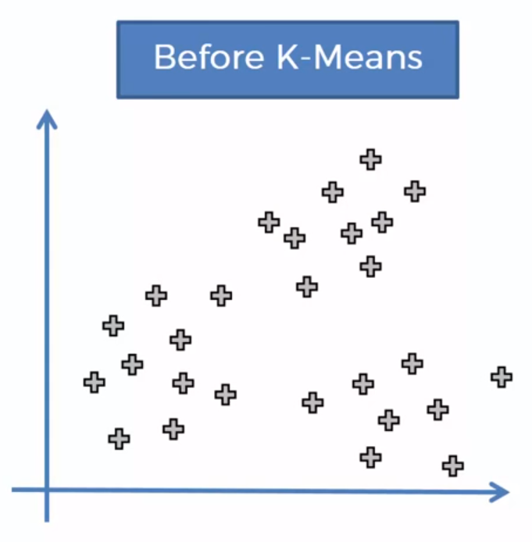
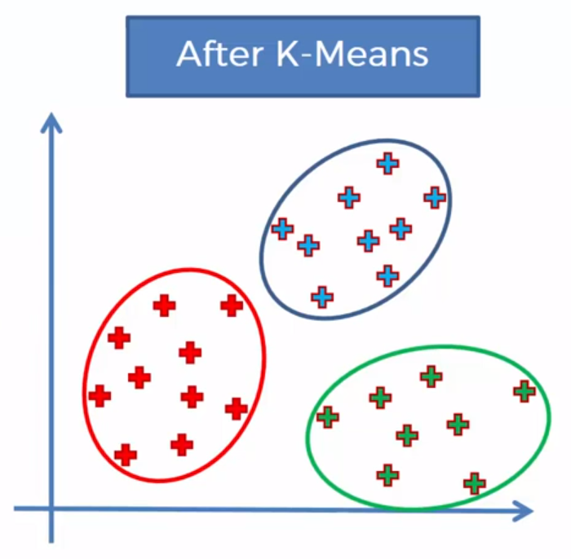
Q: Can we identify groups on this plot?
K-Means clustering

Slide 12
K-Means algorithm
STEP 1: Choose the number K of clusters
STEP 2: Select at random K points, the centroids (not necessarily from your dataset)
STEP 3: Assign each data point to the closest centroid that forms clusters
STEP 4: Compute and place the new centroid of each cluster
STEP 5: Reassign each data point to the new closest centroid. If any reassignment took place, go to the STEP 4, otherwise terminate
Your model is ready

Slide 13
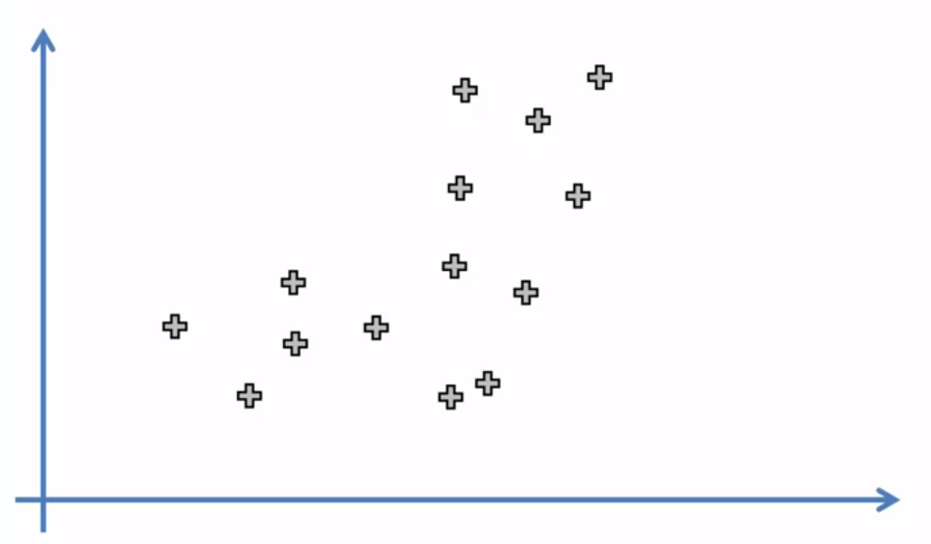
STEP 1
Choose the number K of clusters: K = 2 *usually it is done programmatically in Python or R, but here we will choose it manually

Slide 14
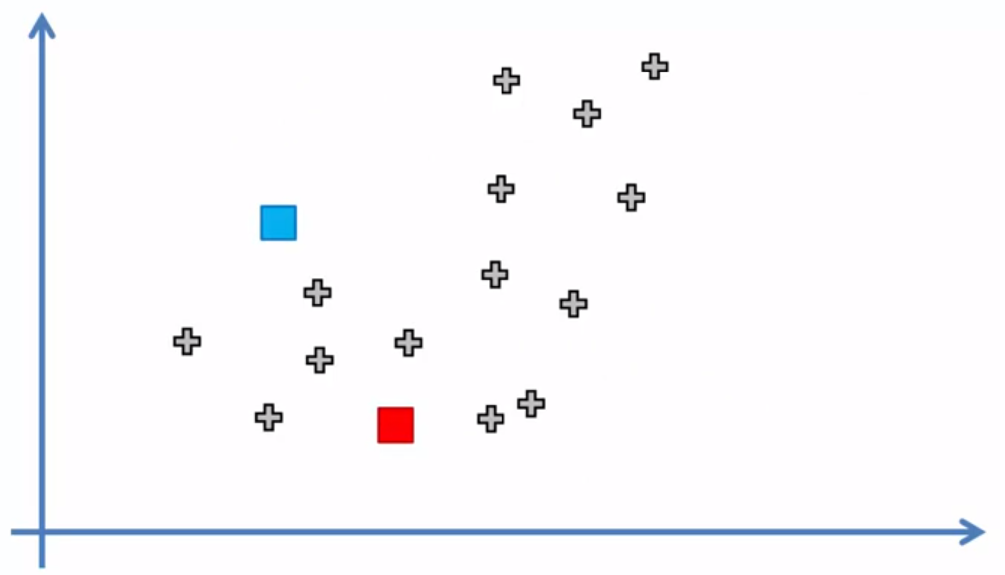
STEP 2
Select at random K points, the centroids (not necessarily from your dataset)

Slide 15
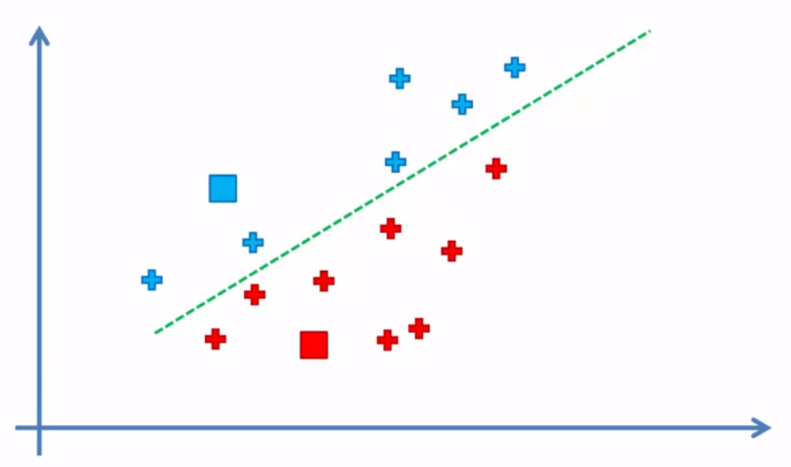
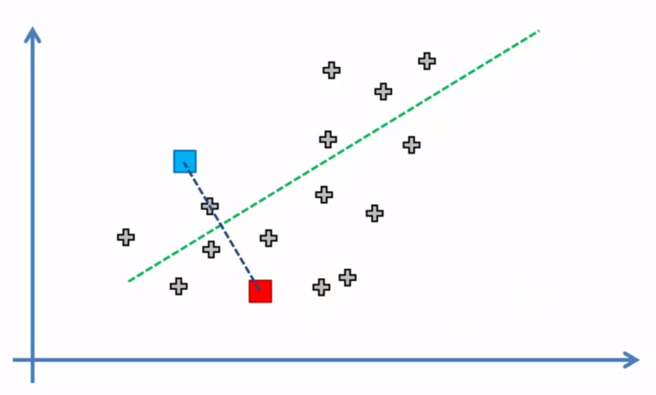
STEP 3
Assign each data point to the closest centroid that forms clusters *again: since we do it manually we will use some hacks from geometry, but in reality it works a bit different

Slide 16
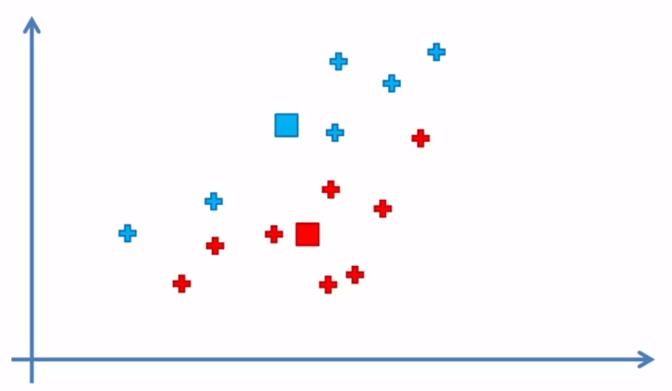
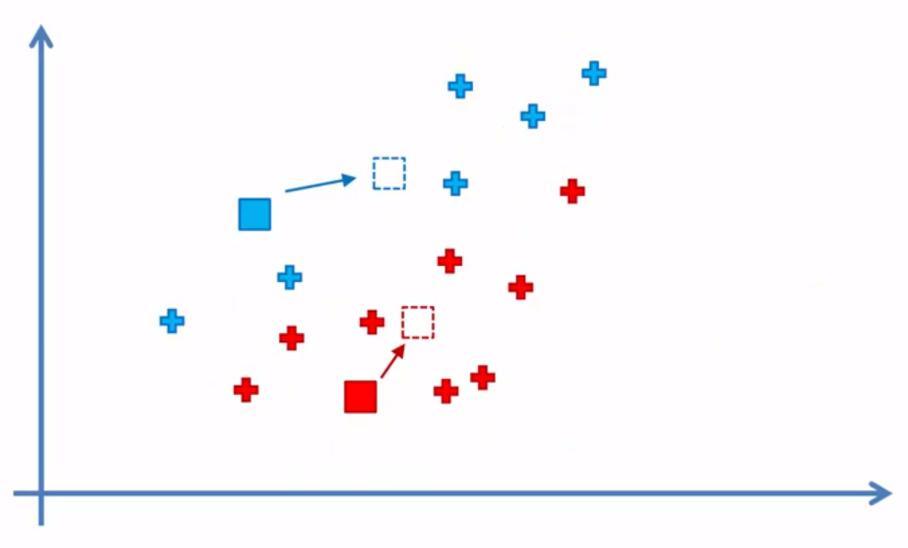
STEP 4
Compute and place the new centroid of each cluster *you need to find a ‘center of mass’ for the centroids by X and Y (visually) and move them towards that points

Slide 17
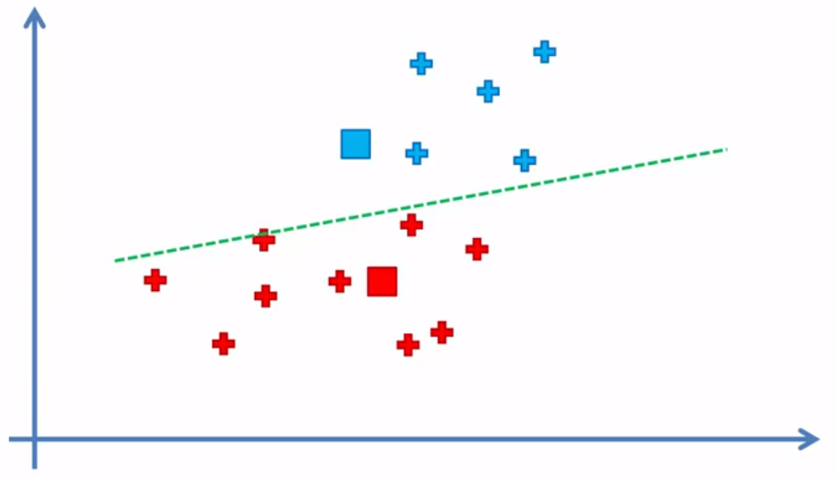
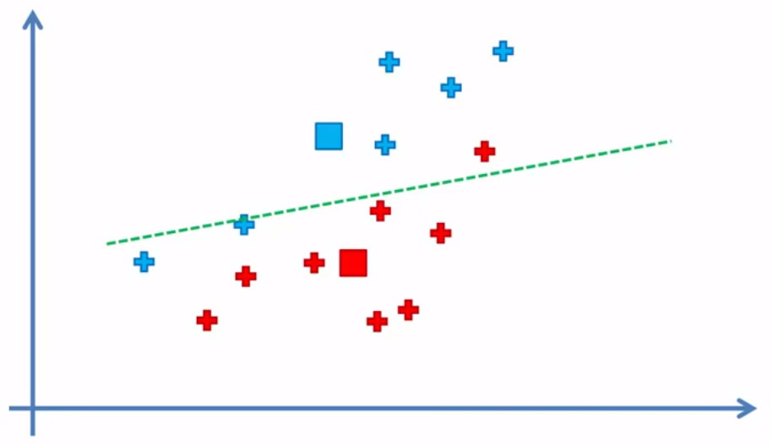
STEP 5
Reassign each data point to the new closest centroid. If any reassignment took place, go to the STEP 4, otherwise terminate *
REASSIGNMANET took place, we go back to STEP 4

Slide 18
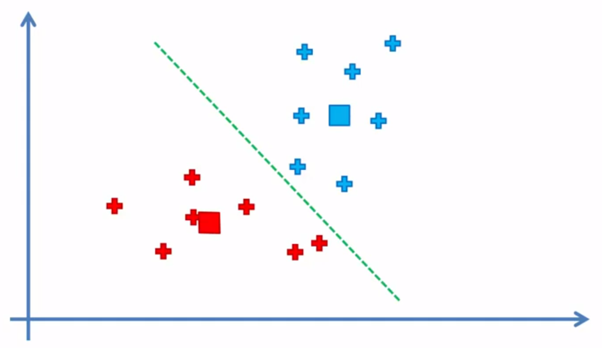
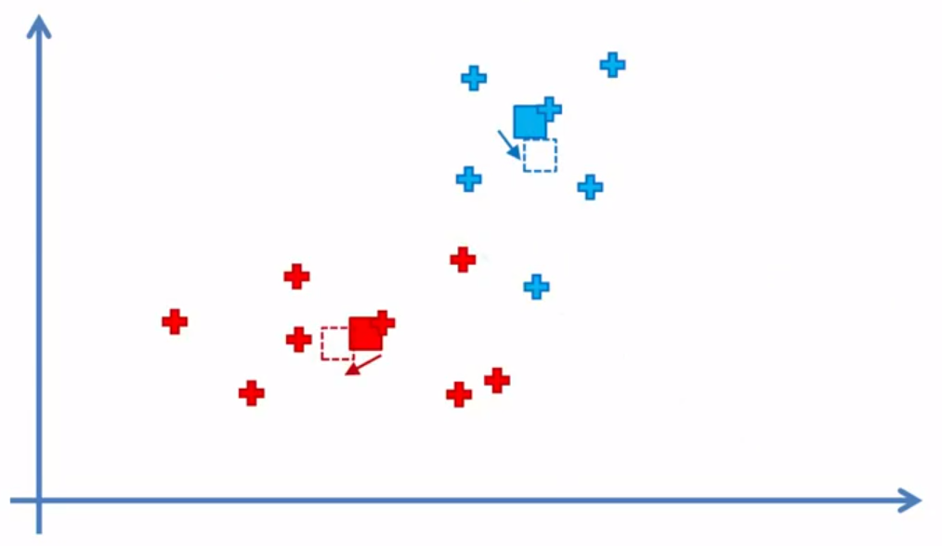
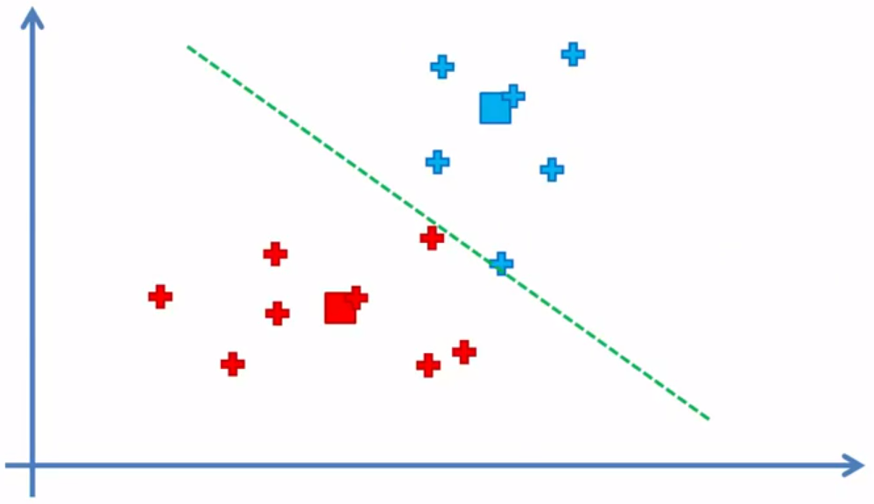
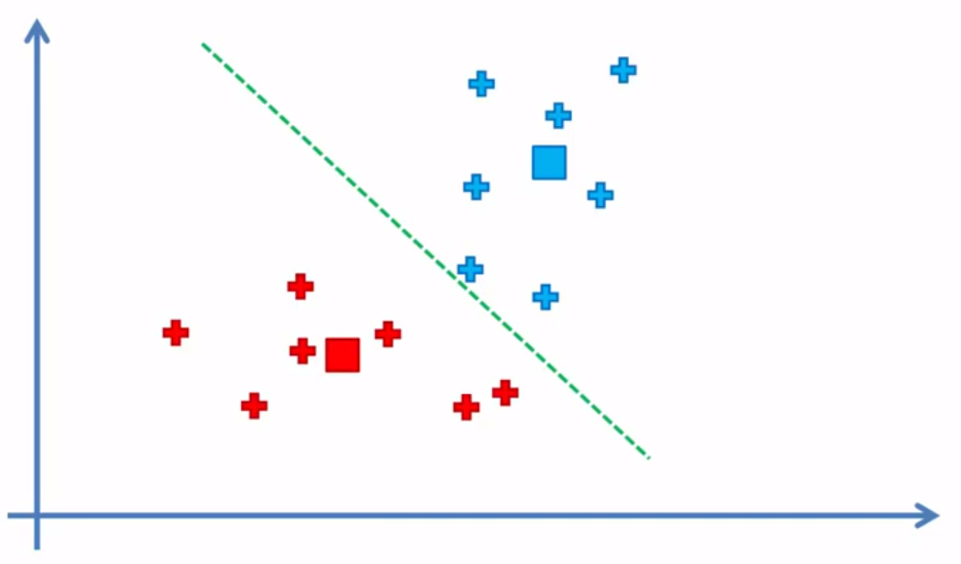
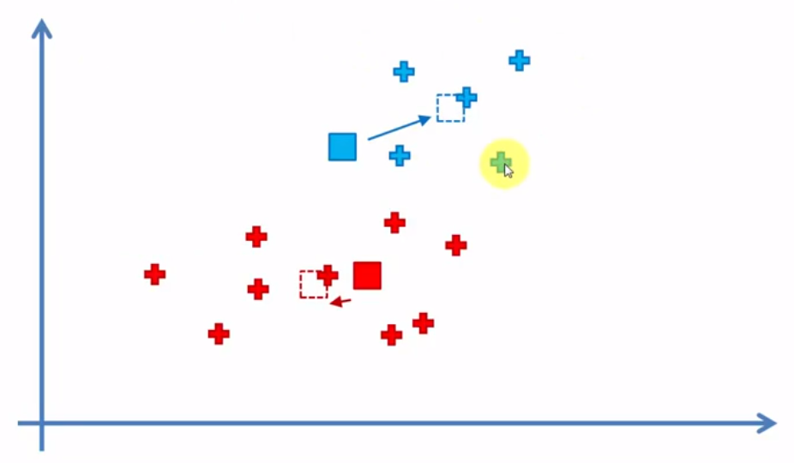
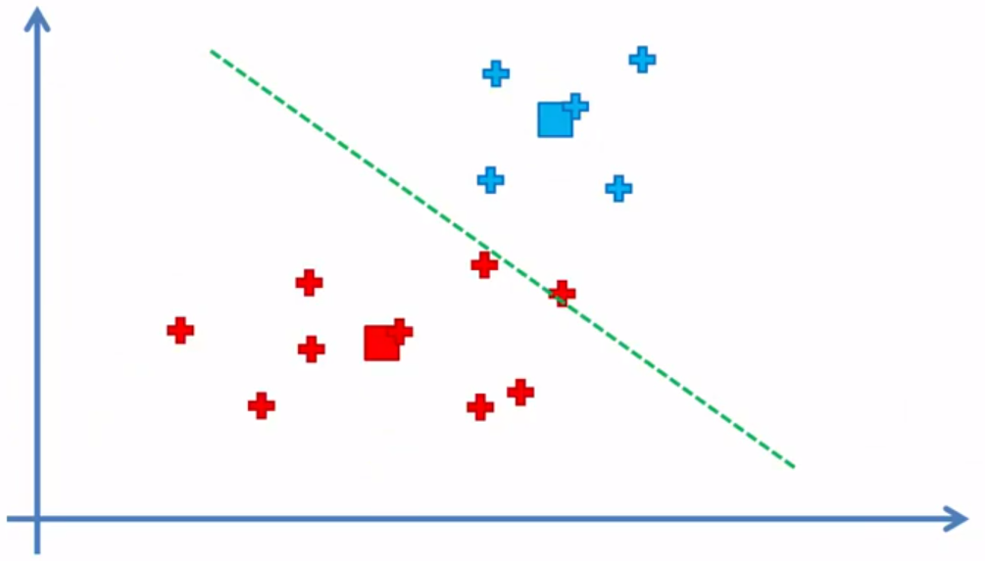
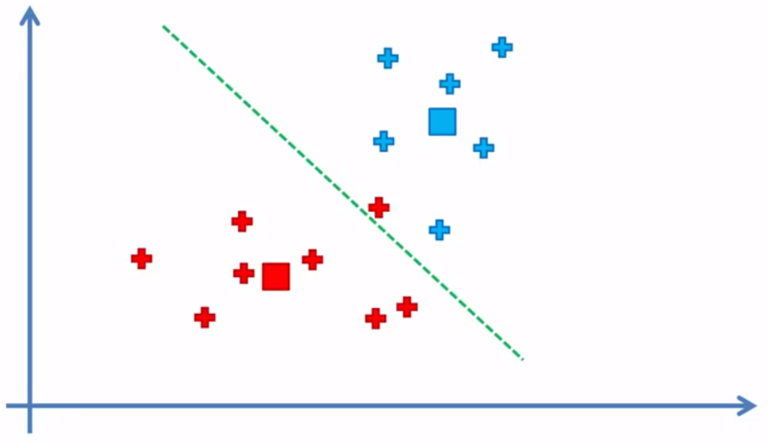
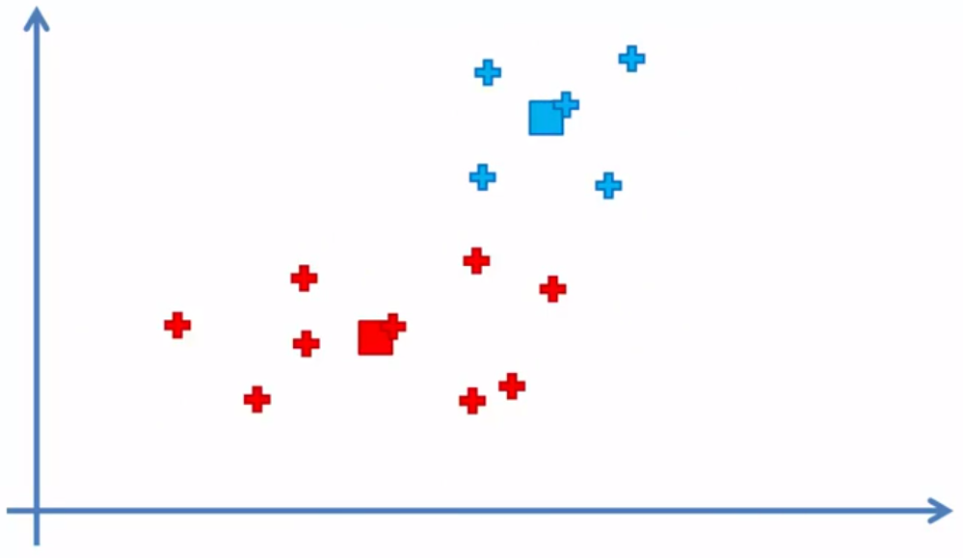
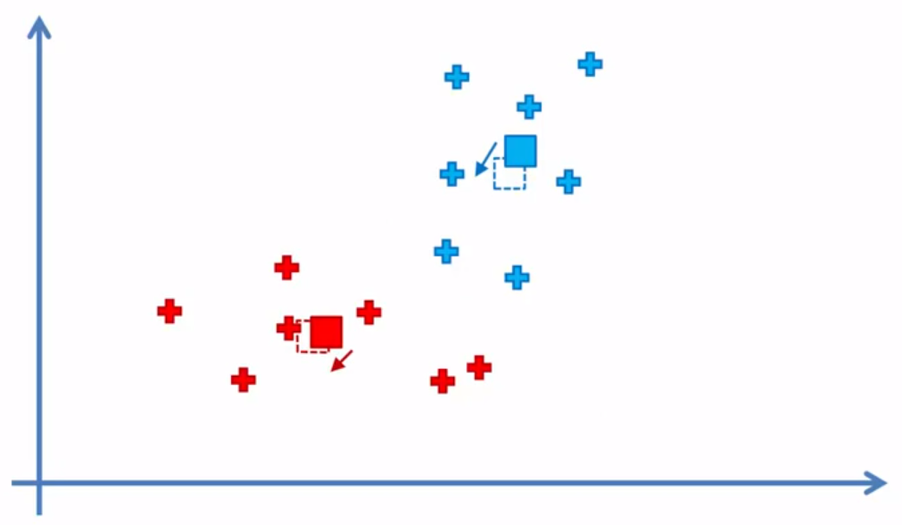
STEP 4
Compute and place the new centroid of each cluster *you need to find a ‘center of mass’ for the centroids by X and Y (visually) and move them towards that points
REASSIGNMANET took place
This is an iterative process, we repeat until the algorithm CONVERGES
Like this: the equidistant line doesn’t reassign any points

Slide 19
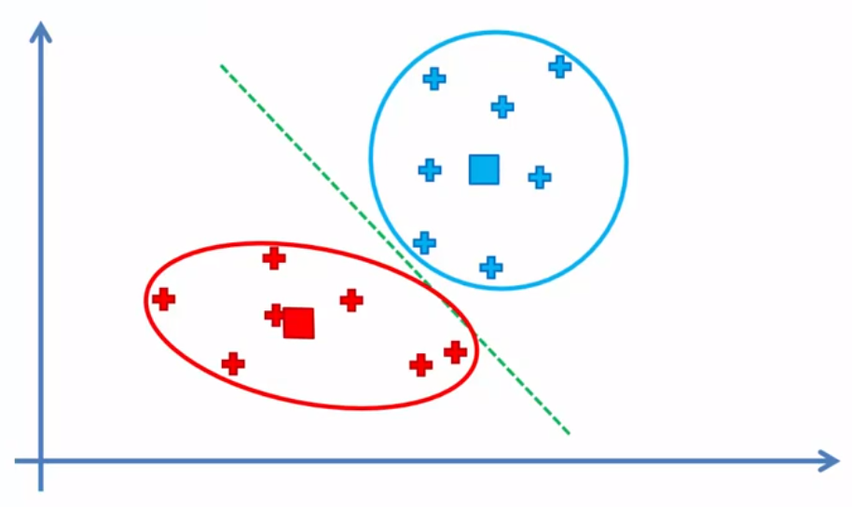
YOUR MODEL IS READY

Slide 20
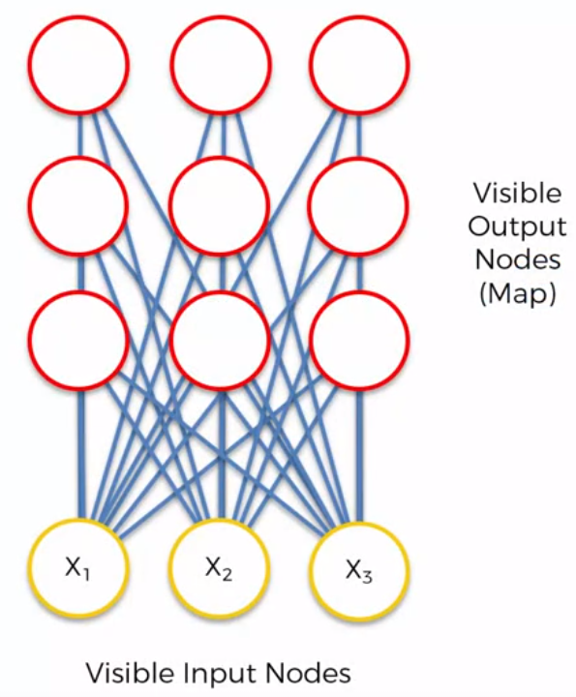
How do SOM work?

Slide 21
How do SOM work?
Q: if SOMs are used for decreasing dimensionality then how come 3 input nodes evolved to !9! output nodes?
A: in fact these 3 inputs are columns, which means that there are also rows present.
Here SOM decreases 3d into 2d

Slide 22
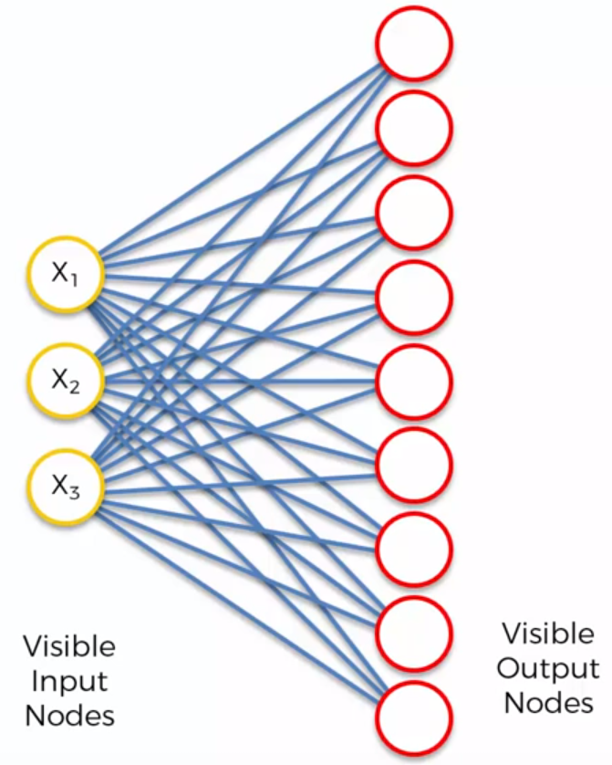
How do SOM work?
Let’s rearrange the view to the more neural networkish view
NB: keep in mind that SOMs are different from traditional NNs, thus the terminology (i.g. weights, synapses etc) may differ as well.

Slide 23
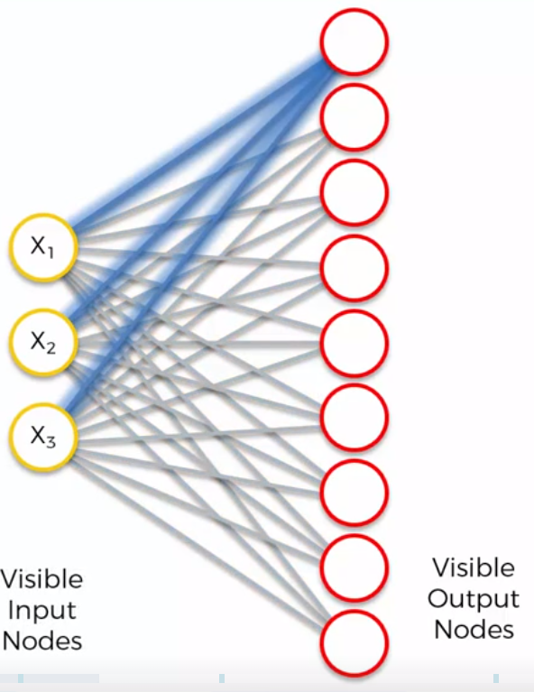
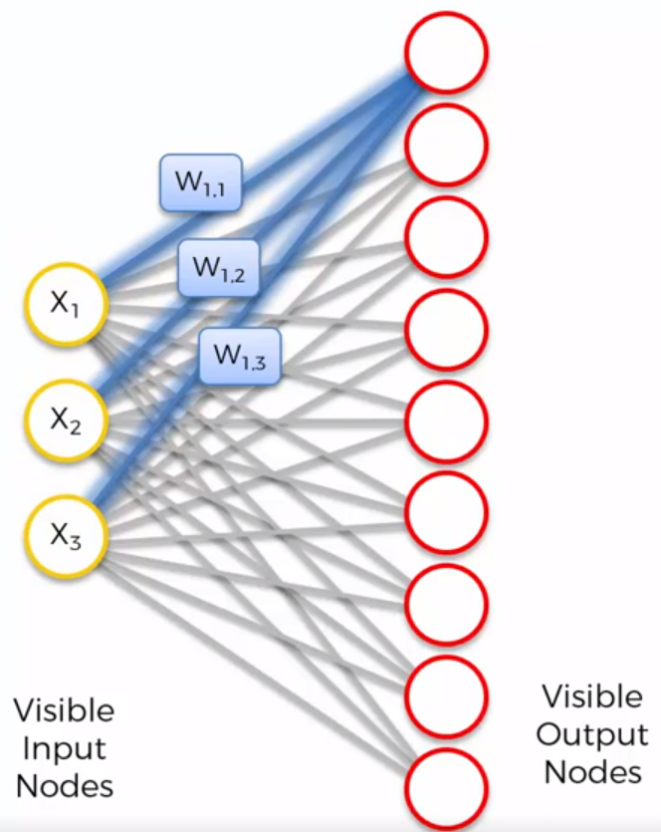
How do SOM work?
The synapses connect the nodes.
W1,1 - means Weight(OutputNode,InputNode)
However weight have different connotation in SOMs in contrast to ANNs.
In ANNs we multiply X by W and apply activation function (AF).
In SOMs there are no AFs. Weights are a characteristic of the nodes itself

Slide 24
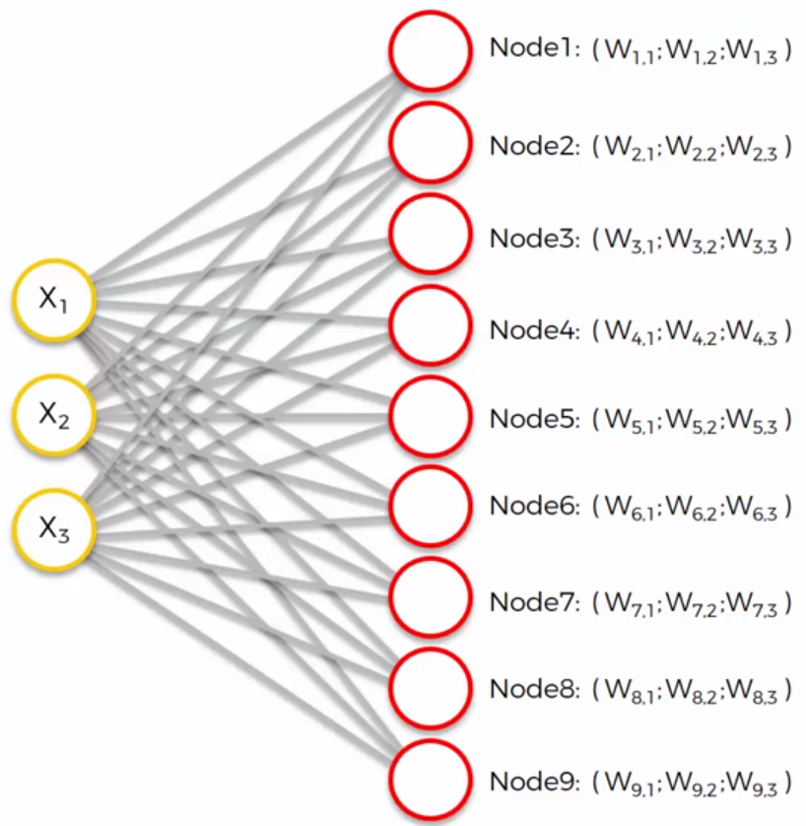
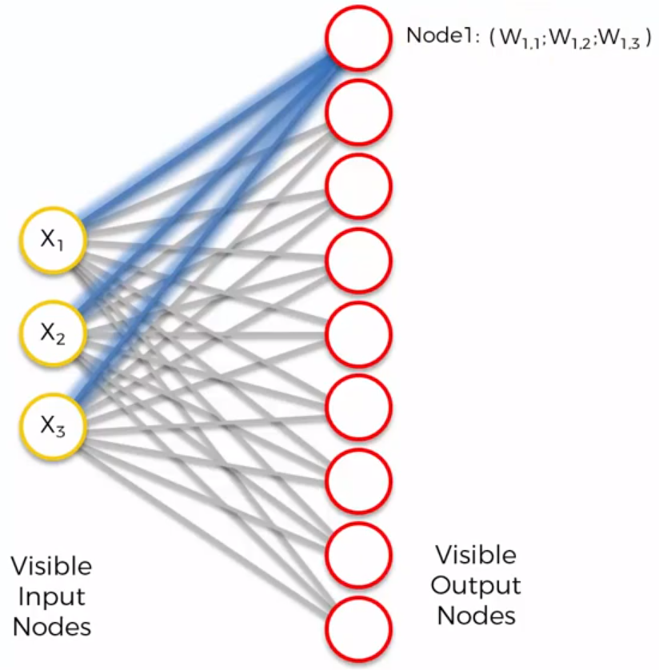
How do SOM work?
The weights are the 3d coordinates of our inputs in our 2d space
Next we will have a COMPETITION among the nodes to find out which of these nodes is closest (or best representative of) to the input row(s)

Slide 25
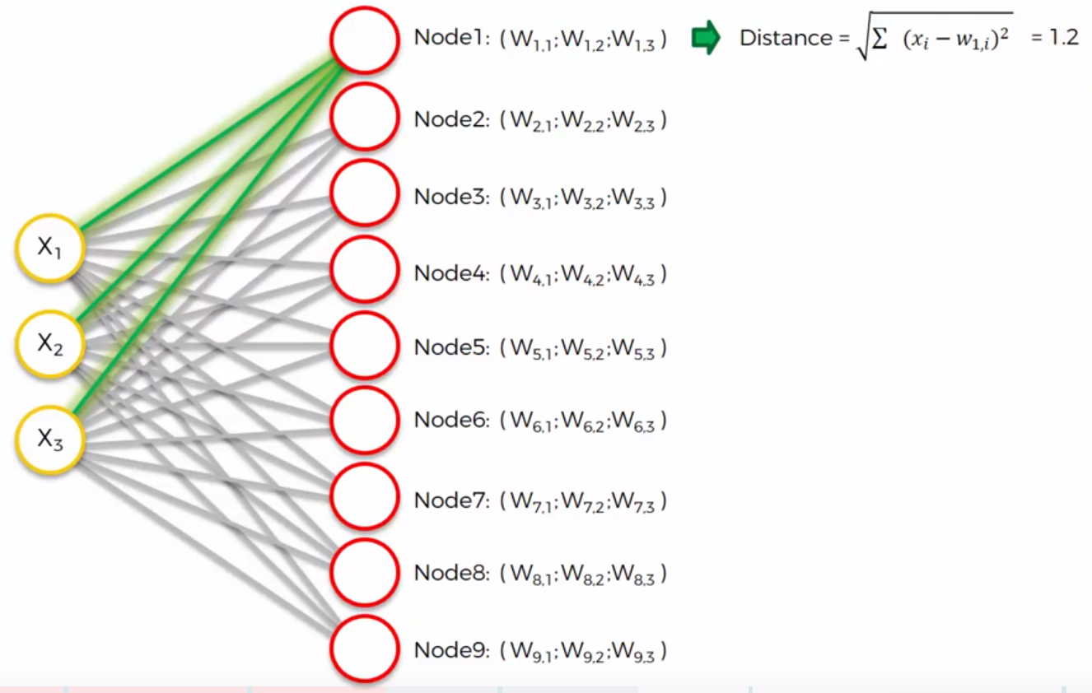
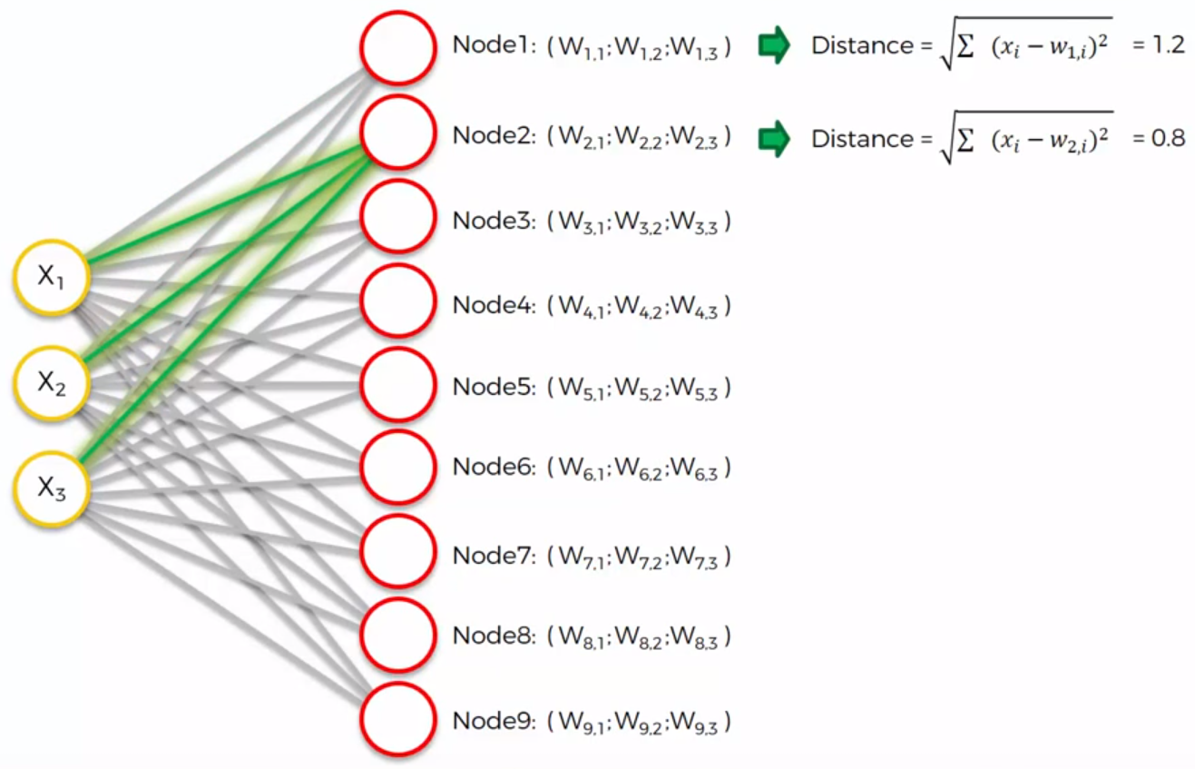
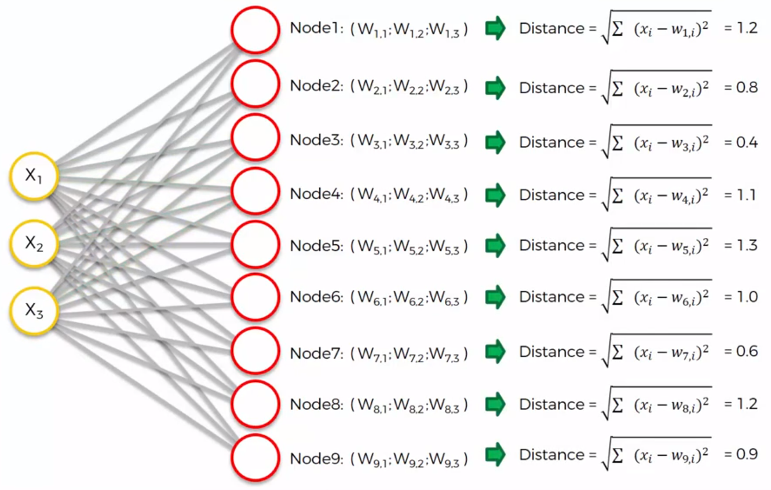
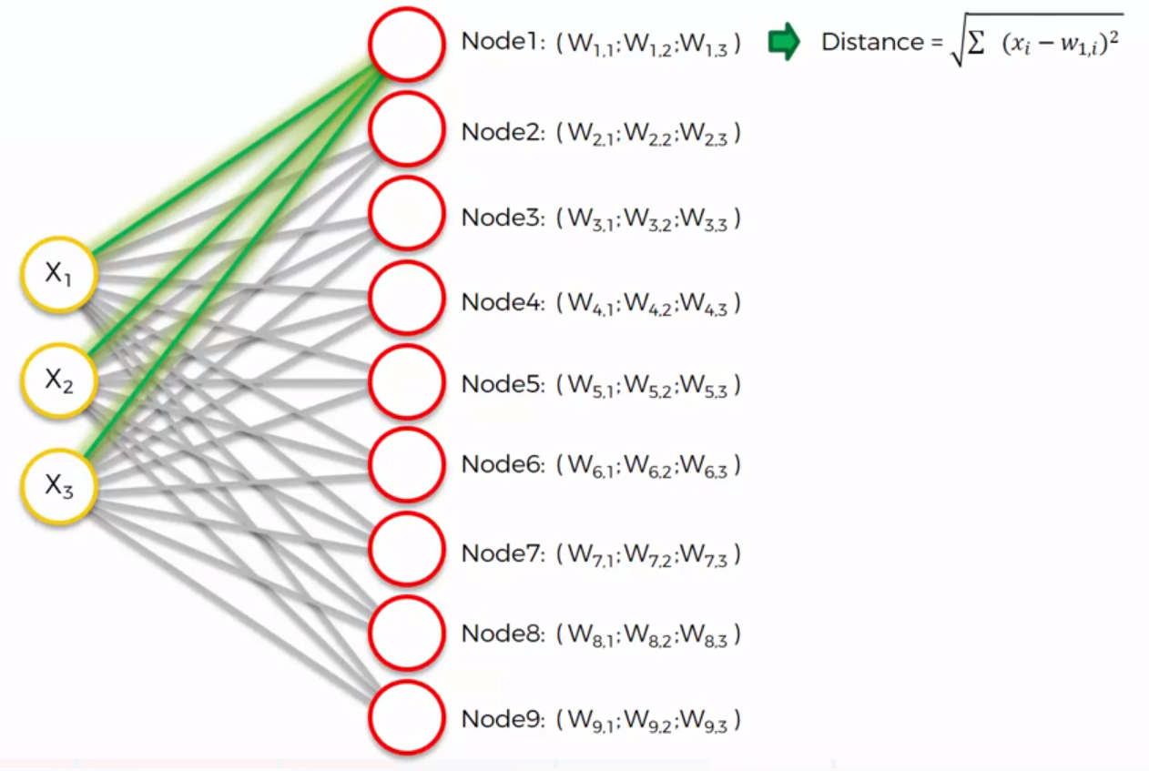
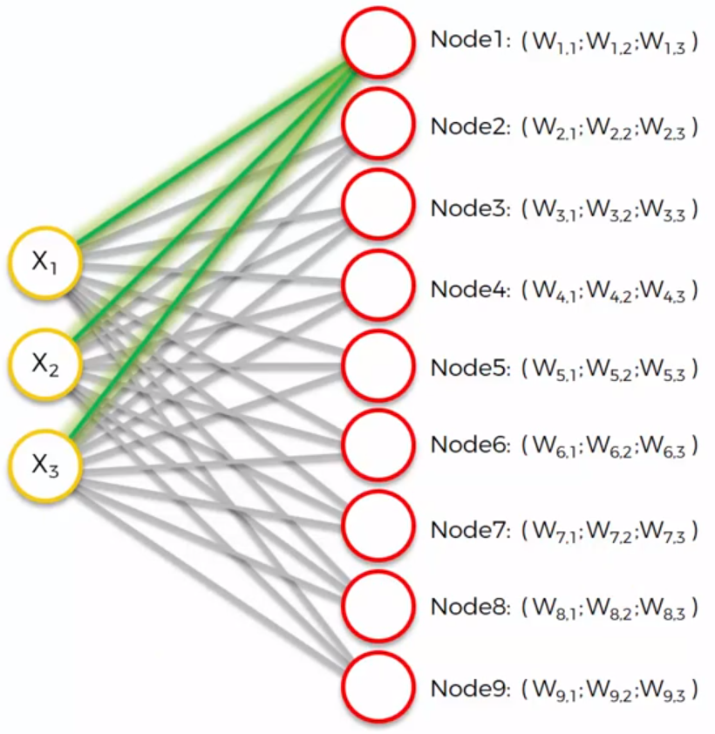
How do SOM work?
BMU – best matching unit
These distance results will be close to 1 because we will scale the inputs

Slide 26
How do SOM work?
Now let’s enlarge our scale to understand it better
Remember that here the main concept is the competition among the nodes
The nodes are trying to pull as many surrounding nodes as they can

Slide 27
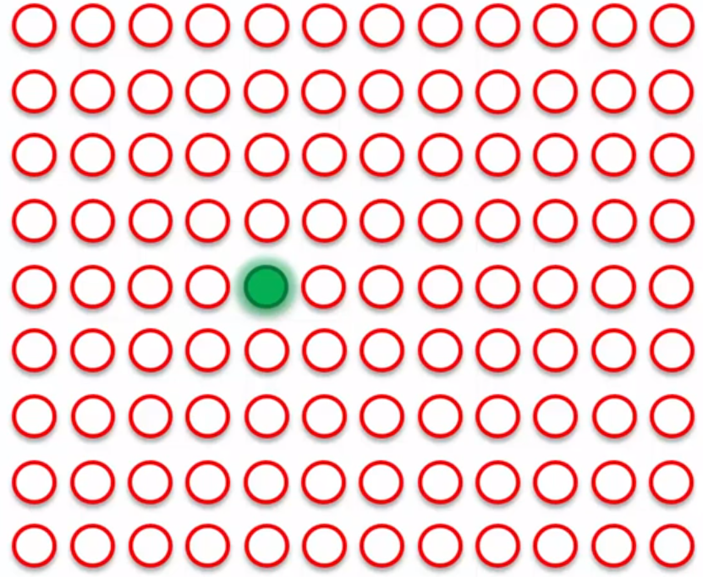
How do SOM work?
Let’s say we found our BMU here (the green node)
These all are ordered rows:
#1, #2 … #n

Slide 28
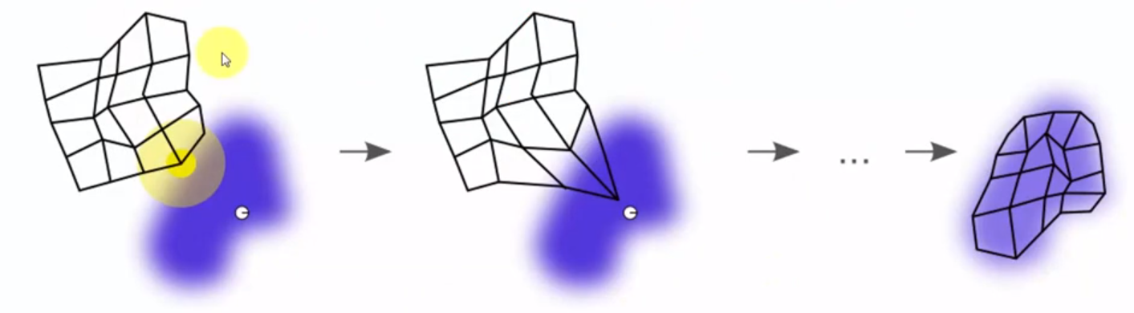
How do SOM work?
Once we update it’s weight the Self Organizing MAP will come closer to that point
The map self organizes itself onto your input data, thus it is SOM
Resource - Wikipedia

Slide 29
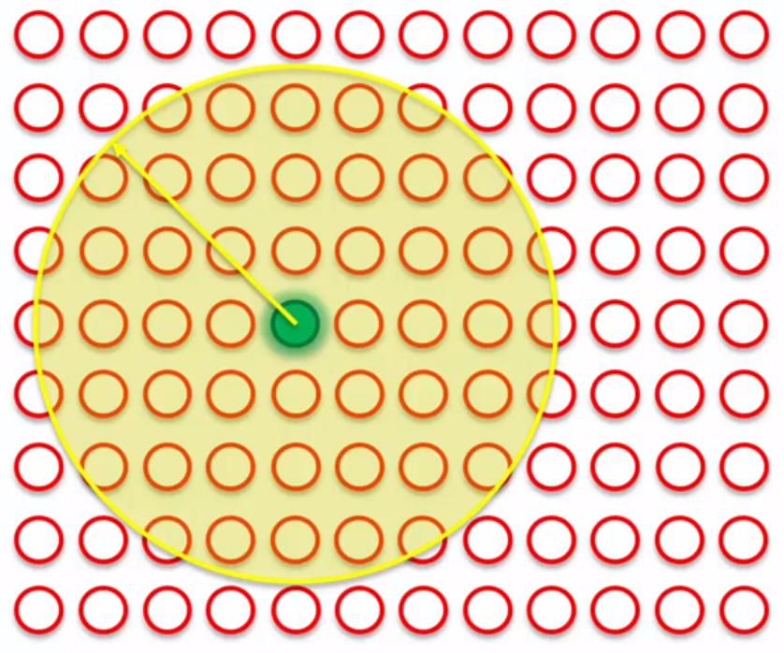
How do SOM work?
The next thing that we have in SOM is the radius around BMU
Every single point that fall inside the circle updates it’s weight. The closer the node to the center, the heavier the weight update is

Slide 30
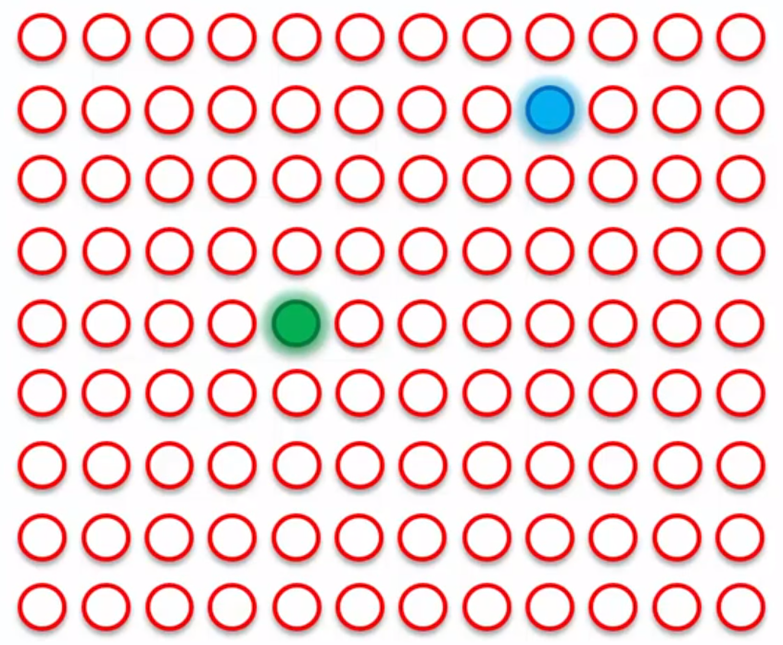
How do SOM work?
Let’s say we found BMU for row #2
It updates the surrounding (in radius) nodes as well

Slide 31
How do SOM work?
Q: But how do they actually fight with each other?

Slide 32
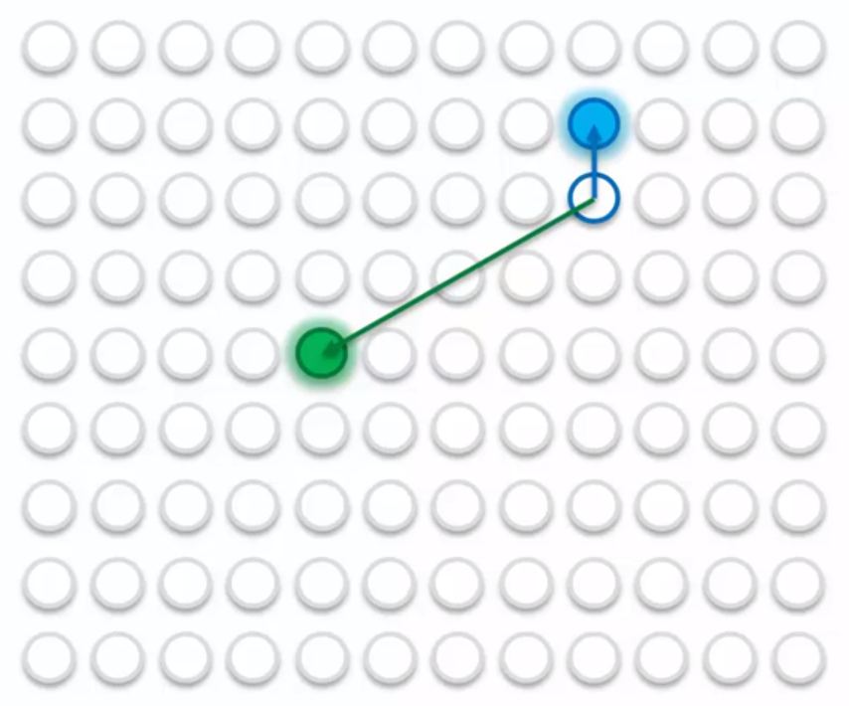
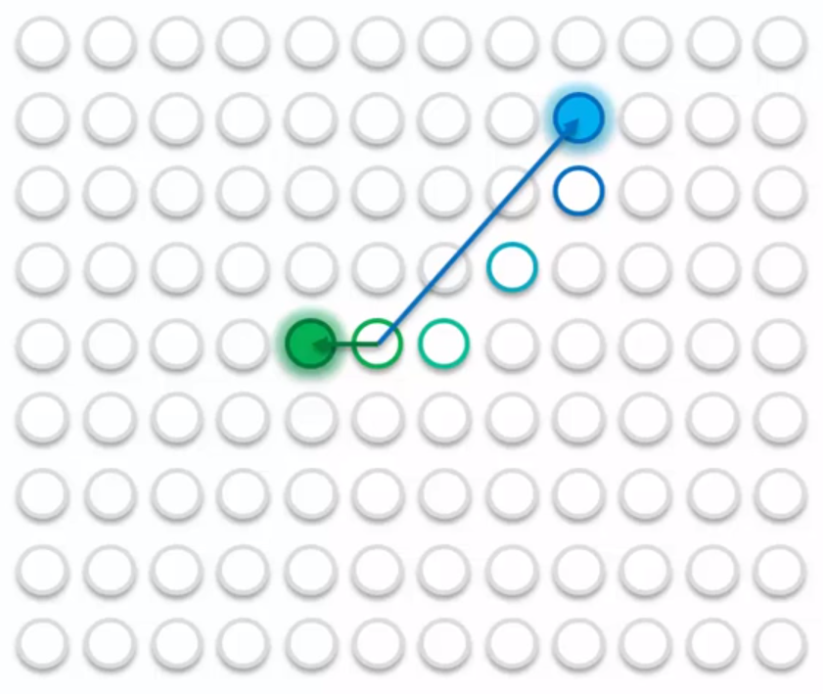
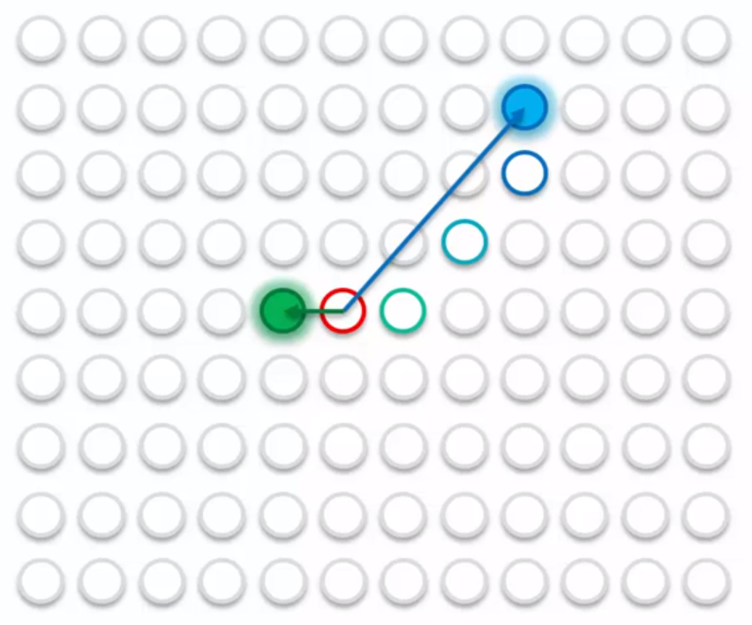
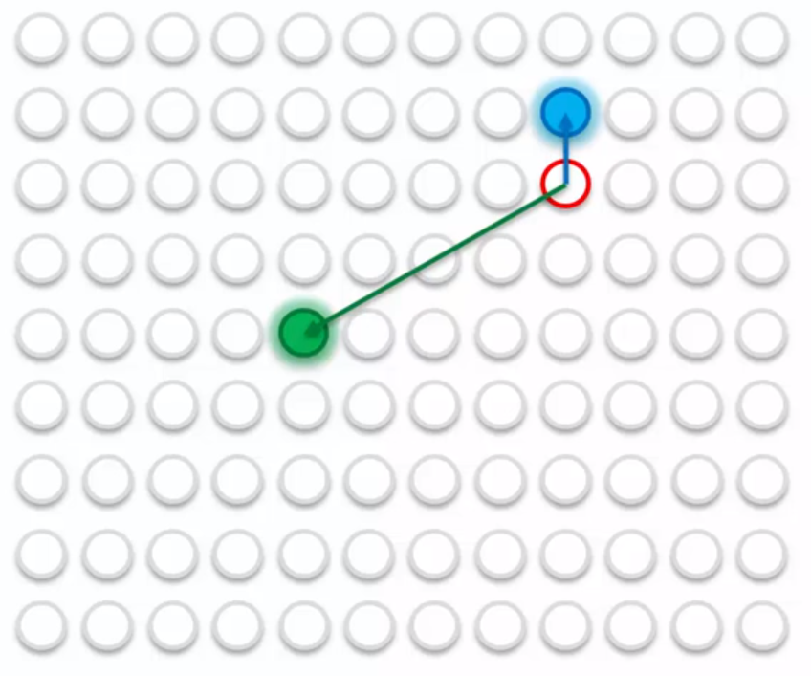
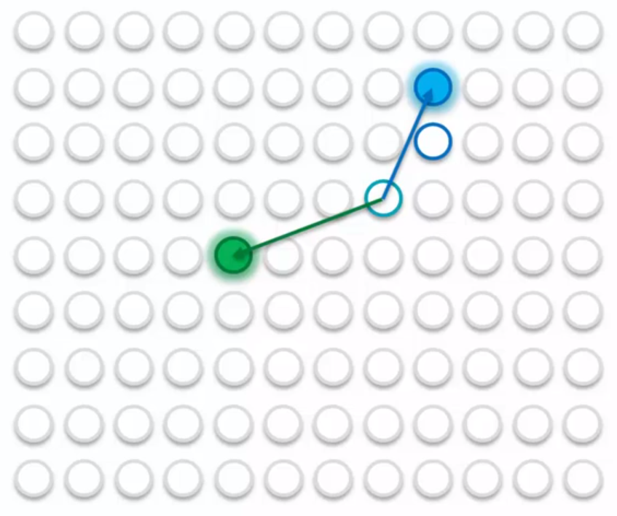
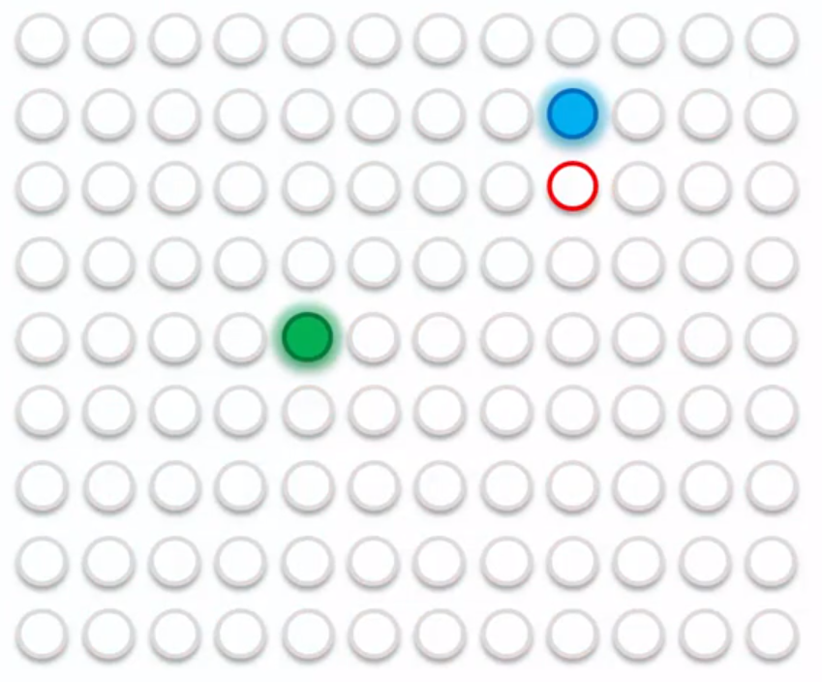
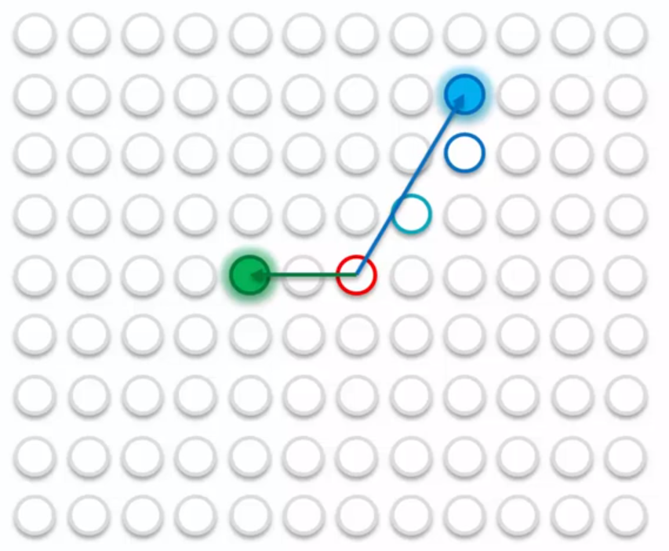
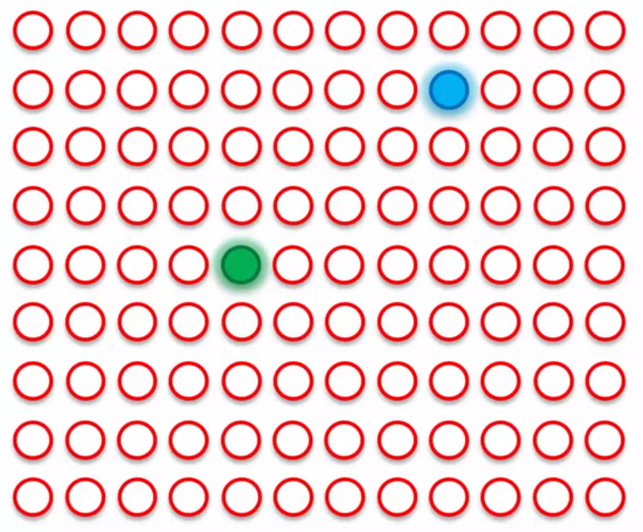
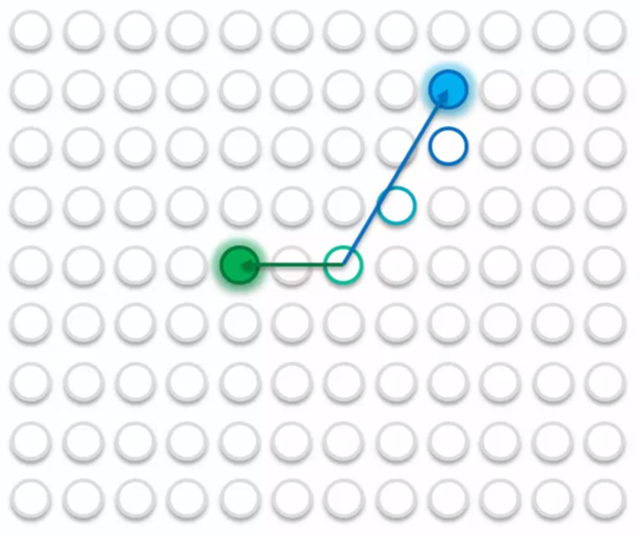
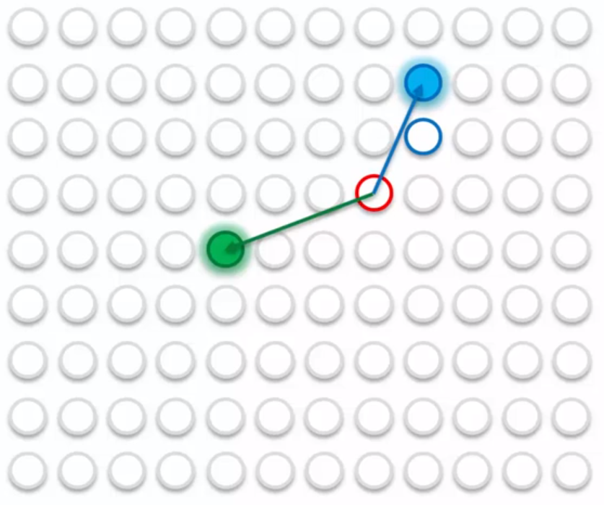

Slide 33
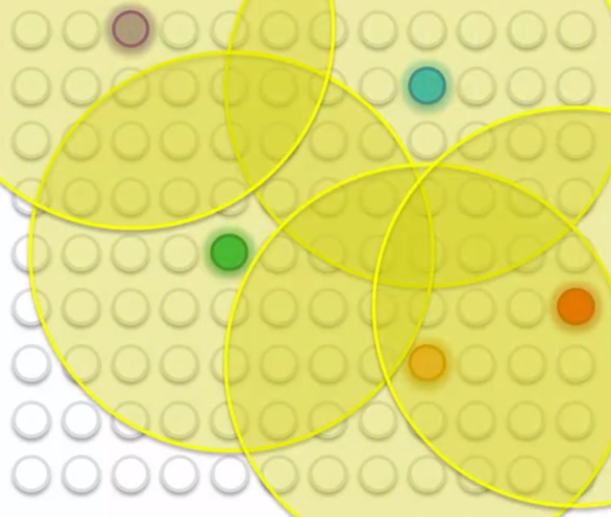
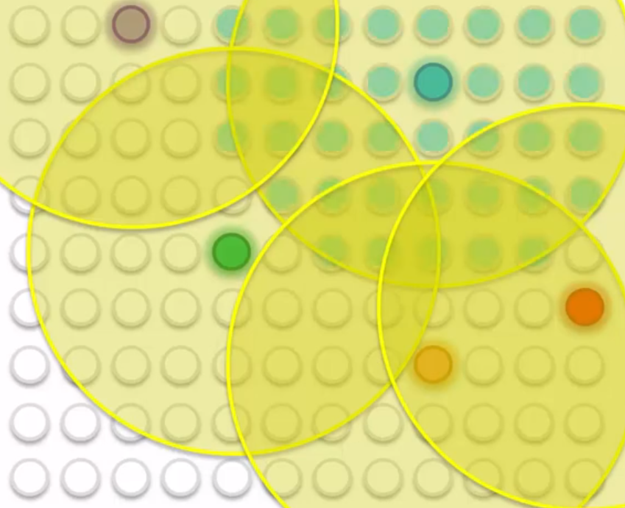
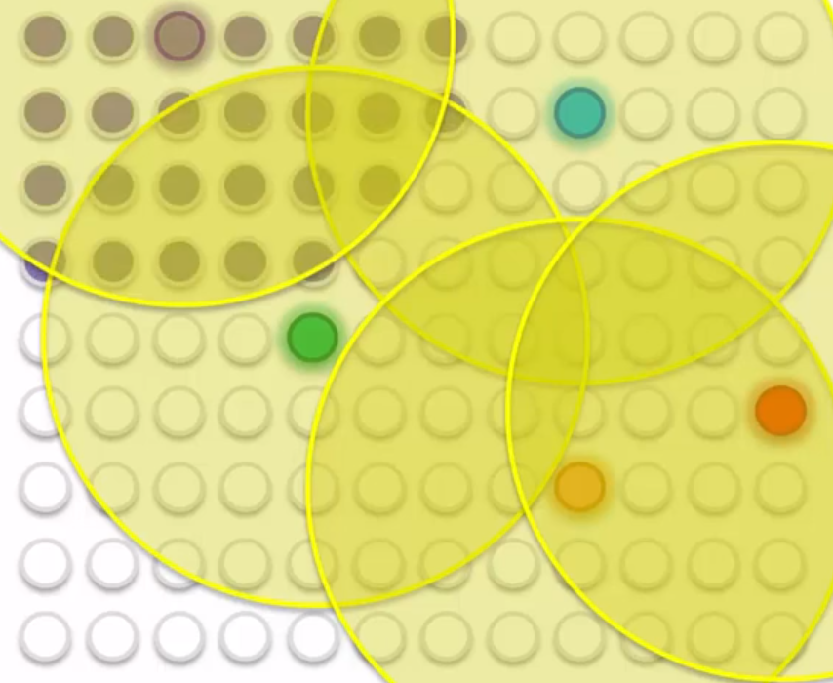



Slide 34
How do SOM work?
After a one epoch of algorithm a unique feature of Kohonen algorithm is applied – which means that your radius is shrinked

Slide 35



Slide 36



Slide 37
How do SOM work?
The process becomes more accurate over the epochs reaching a very precise alignment
The map self organizes itself onto your input data, thus it is SOM
Resource - Wikipedia

Slide 38


Slide 39
Important to know
SOMs retain topology of the input dataset
SOMs reveal correlations that are not easy to identify
SOMs classify data w/out supervision
No target vector -> no backpropagation
No lateral connection between the nodes

Slide 40
Appendix
http://databank.worldbank.org/data/reports.aspx?source=world-development-indicators
http://www.cis.hut.fi/research/som-research/worldmap.html
http://www.ai-junkie.com/
http://www.ai-junkie.com/ann/som/som1.html

